Slide 1
Kate Bond Elementary Title I Annual Meeting August 17, 2022
Presented by
PLC Coaches
Lisa Aven
Koedy Harper

Slide 2
Title I (pronounced “Title One”) is the largest federally funded program for elementary, middle, and high schools. Through Title I, the Federal government gives money to school districts around the country based on the number of low-income families in each district.
What is Title I

Slide 3
Title I was passed in 1965 under the Elementary and Secondary Education Act (ESEA). It is the largest federal assistance program for our nation’s schools. Title I schools receive extra funding (Title I dollars) from the federal government. These dollars are used to: identify students experiencing academic difficulties and provide assistance to help these students; purchase additional staff, programs, materials, and/or supplies; and conduct parent and family engagement meetings, trainings, events, and/or activities.
What is a Title I School?

Slide 4
What Can I spend Title I funds on?
In general, Title I funds may be used for:
additional supplementary staff,
additional training for school staff,
extra time for instruction (before and/or after school programs),
parent and family engagement activities, and/or
a variety of supplemental teaching materials, equipment, and technology.

Slide 5
How does KBE use Title I money?
2 PLC Coaches
Keeps our school updated on technology
Each classroom has computers and a Promethean Board
Each grade has a laptop cart
Computer lab
Resources for classrooms

Slide 6
School Curriculum
Reading – Wonders/Reading Horizons/Ready Reading
Math – Eureka Math /Ready Math
McGraw Hill Social Studies/Social Studies Weekly/Gibbs Smith
Science – Inspire Science McGraw Hill

Slide 7
Academic Assessments
Grade Level Common Assessments
Mastery Connect 3 times a year (Reading, Math & Science)
I-Ready 3 times a year (Reading & Math)
AimsWeb Assessments (Reading & Math)
TCAP (Grades 2-5)

Slide 8
Policies for Family Engagement
Kate Bond Elementary School’s handbook which is in our Agenda Book contains our Family Engagement Plan. All parents should have received the Agenda Book the second week of school. In addition, it is posted on our school’s webpage.
There are many opportunities for parents to participate at school events.
Reporting Pupil Progress
Grades are posted in Powerschool
Progress Reports every 4 ½ weeks
Report cards every 9 weeks
Parent Conferences
Kate Bond Elementary will hold parent conferences where the progress of students will be discussed and explained.
Thursday September 8th
Thursday February 16th
Teachers will schedule meetings before school, during their planning time, and after school to accommodate parent schedules throughout the school year. Each teacher also has “office hours” to communicate with parents.

Slide 9
Parental Involvement Requirements
Attend School Events
Become School Supporters
Respond to memos, surveys, and questionnaires expressing ideas and concerns
Help monitor their child’s virtual lessons

Slide 10
Availability of Parent Training
Training will be offered by grade level during the school year. Watch for a flyer with date and time.

Slide 11
State Report Card
http://www.tn.gov/education/topic/report-card
For the 2019 school year we made
Reward School Status!
Reward status is the top distinction a school can earn in Tennessee. Reward schools are those that are improving overall student academic achievement and student growth for all students and for student groups, and they are identified annually.

Slide 12
Kate Bond Elementary is considered a Level 5 School
A Level 5 composite means we are successfully moving students toward proficiency and beyond. We understand not all students start at the same place. Significant growth, as characterized by a Level 5, means our students are rebounding from the negative impacts of the pandemic, our teachers are effectively helping students to reach academic goals, and our curriculum plan is getting results.

Slide 13
SCHOOL IMPROVEMENT PLAN
The SIP is updated yearly to meet the needs of the students at Kate Bond Elementary.
A copy is available on the website.
If you are interested in helping us revise our SIP please let me know at the end of the meeting or by emailing one of the PLC Coaches.

Slide 14
Opportunities for Additional Parent Meetings
If you have a suggestion for what you as a parent would like to have as a training please let me know on the evaluation form.

Slide 15
Staffing Qualifications
Teacher Qualifications
All teachers working in a program supported by Title I funds must meet the state’s certification and Licensing requirements, including any requirements for certification obtained through alternative routes to certification (ESSA Section 1111(g)(2)(J)
Paraprofessional Qualifications
All paraprofessionals with instructional duties and working in a program support by Title I funds must hold a high school diploma or its recognized equivalent and one of the following (ESSA Section 1111(g)(2)(J):
Two years of college
Associate’s degree
Pass a formal state or local academic assessment (Parapro)

Slide 16
Parent’s Right to Know
A teacher’s professional qualifications, licensure, grade(s) certification, waivers
A teacher’s baccalaureate and/or graduate degree, fields of endorsement, previous teaching experience
A paraprofessional’s qualifications
An annual notice of Student Education Records Privacy and notice for disclosure of School Directory Information
An assurance that their child’s name, address and telephone listing not be released to military recruiters

Slide 17
All parents will receive information on the following:
Their child’s level of achievement on each of the state’s academic assessments
Notification of right to transfer their child to another school in the district if the student becomes the victim of a violent crime or is assigned to an unsafe school
District Family Involvement Policy and School Parent Involvement Policy
School /Parent Compact
Their right to public school choice, Supplemental Educational Services and more effective involvement if their child’s school is identified for school improvement.

Slide 18
School/Parent Compact
Kate Bond Elementary School’s handbook which is in our Agenda Book contains our School/Parent Compact. All parents should have received the Agenda book when they picked up their child’s supplies. In addition, it is posted on our school’s webpage.
This compact has the responsibilities are the parent, student, teacher and school. We must all work together to make this a successful school year.

Slide 19
Student Code of Conduct
Student Conduct Policy can be found in the SCS Student-Parent Handbook
We will send it home as soon as it is available.

Slide 20
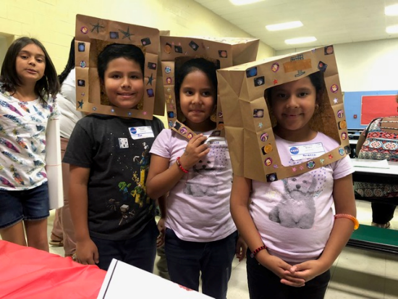
How can Title I help me as a parent?
Title I money can be used for many types of parent involvement activities.
It can be spent on:
o Family literacy activities;
o Parent meetings and training activities;
o Materials that parents can use to work with their children at home.
o Parent resource centers.

Slide 21
Get to know your child’s school…….
Attend school events
Join parent’s organizations
Volunteer
Attend parent-teacher conferences
Request additional meetings
Keep teachers informed
Ask about training programs

Slide 22
If you need more information
Lisa Aven or Koedy Harper
Title I PLC Coaches
avenlc@scsk12.org
harperk@scsk12.org

Slide 24
Please fill out the survey below.

